Slide 1

Source Code & GitHub Repository: MaidEase
Team 1 - Rushda Mansuri Tahera Shaikh Nidhi Berde Amala Natu Bhakti Palkar Jahid Hassan Sai Manish Avasarala Sai Teja Malladi

Slide 2


GitHub URL
https://github.com/Saiteja1807/MaidEase

Slide 3

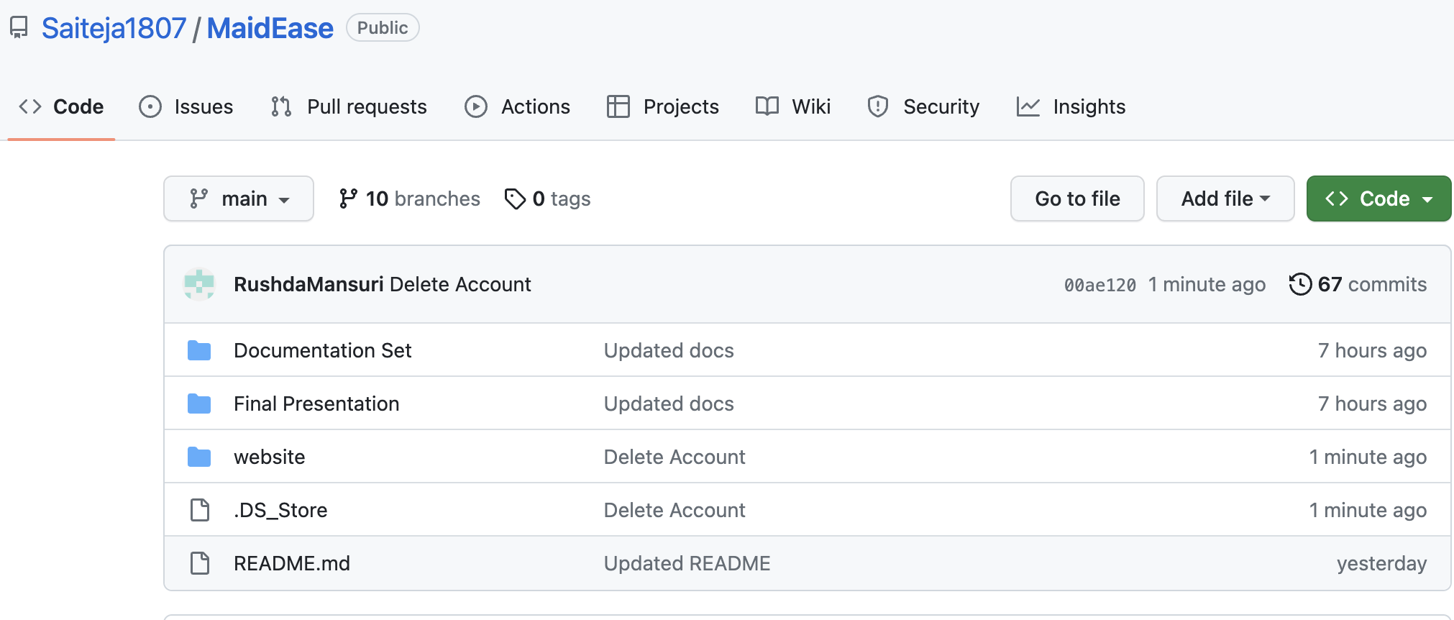
Repository Structure

Slide 4
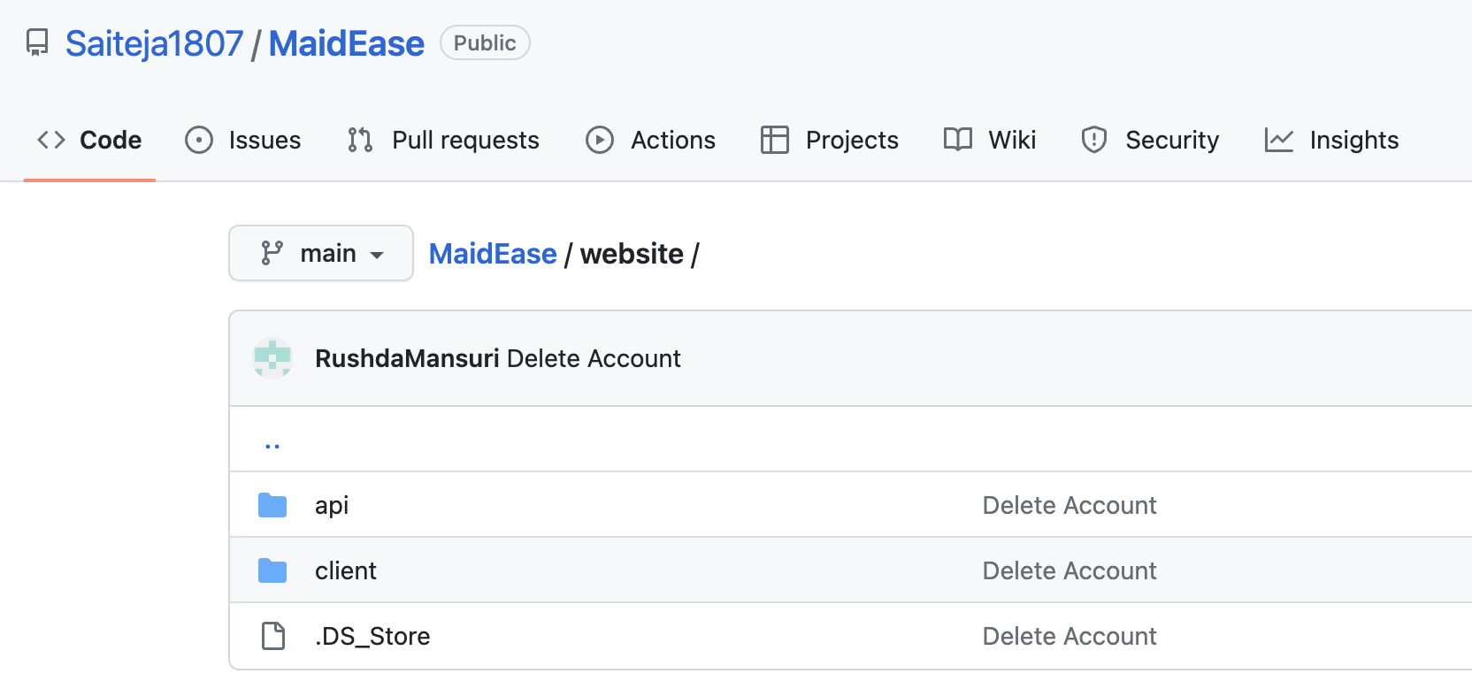

Repository Structure - Code
URL: https://github.com/Saiteja1807/MaidEase/tree/main/website

Slide 5

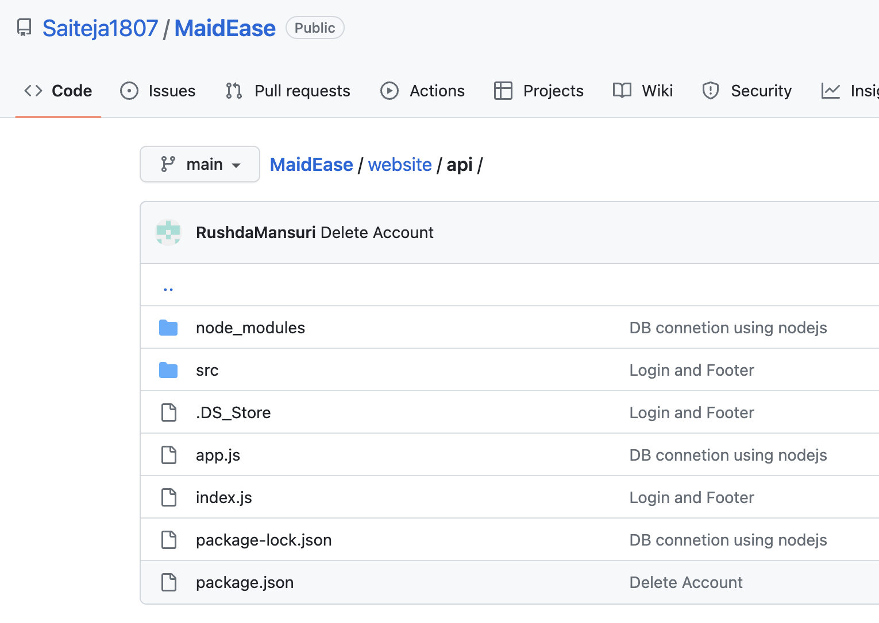
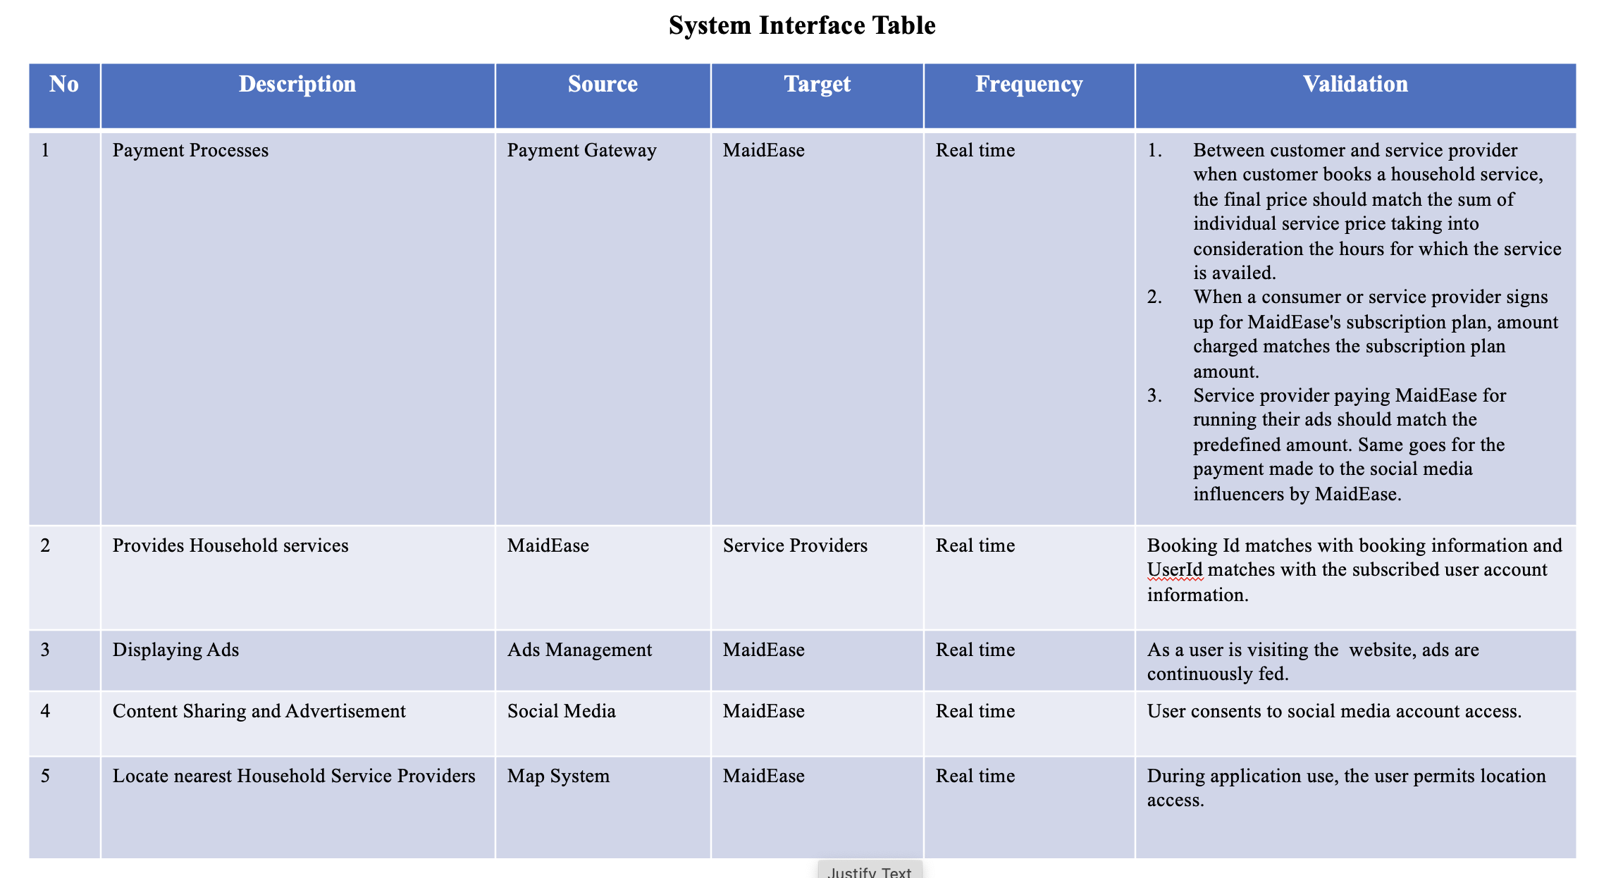
Context Diagram, System Interface Table -- Shaikh
Repository Structure – Code (server ->api)
URL: https://github.com/Saiteja1807/MaidEase/tree/main/website/api

Slide 6

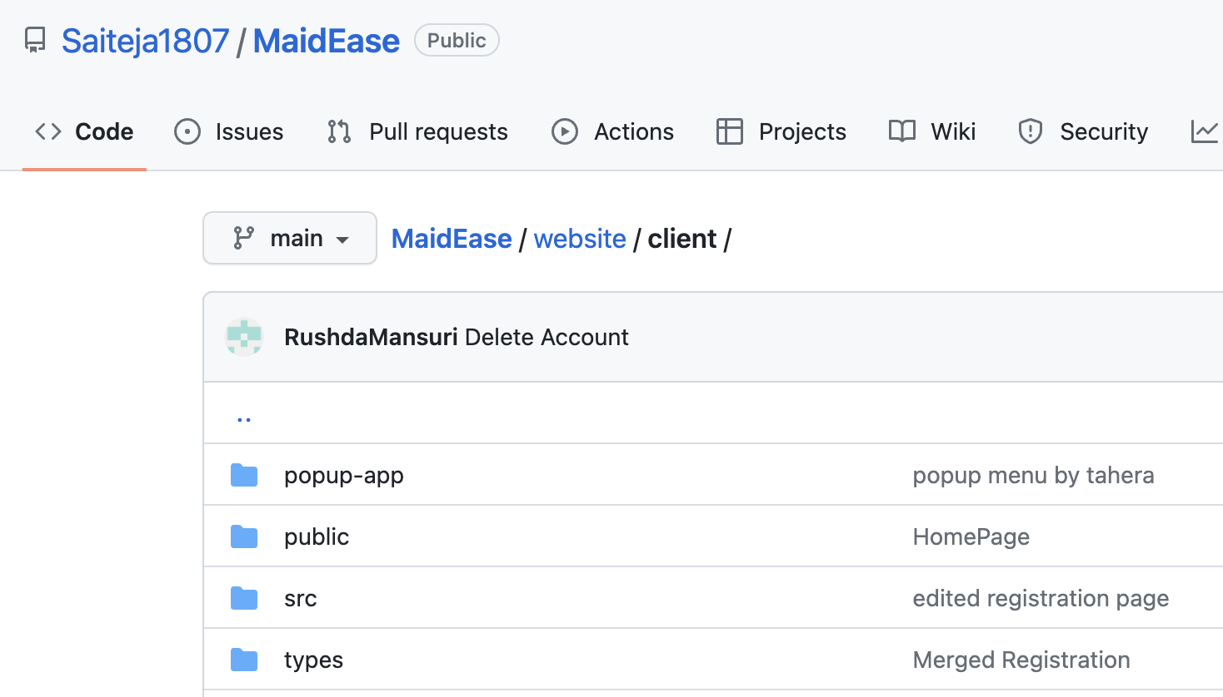
Context Diagram, System Interface Table -- Shaikh
Repository Structure – Code (client)
URL: https://github.com/Saiteja1807/MaidEase/tree/main/website/client

Slide 7





Front-End Technologies

Slide 8


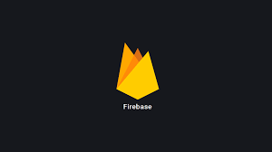


Back-End Technologies

Slide 9

Build & Deployment Procedures

Slide 10


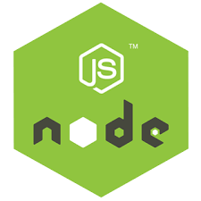

Node.js, React.js and MySQL must be installed on your local machine.
Prerequisites
Node.js and Text Editor
(VS Code) must be installed on your local machine.

Slide 11
Installation Steps:
-> Clone this repository to your local machine.
-> Open the server folder in command line and run the following command:
npm install express
npm install cors
npm install mongoose
npm install bcryptjs
npm install jsonwebtpken
-> Open the client folder in command line and run the following command: npm install
-> To run client code use command npm start
-> To run server code use command npx nodemon index.js

Slide 12
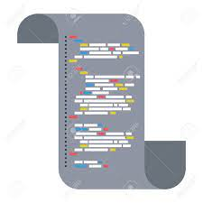

Source Code

Slide 13
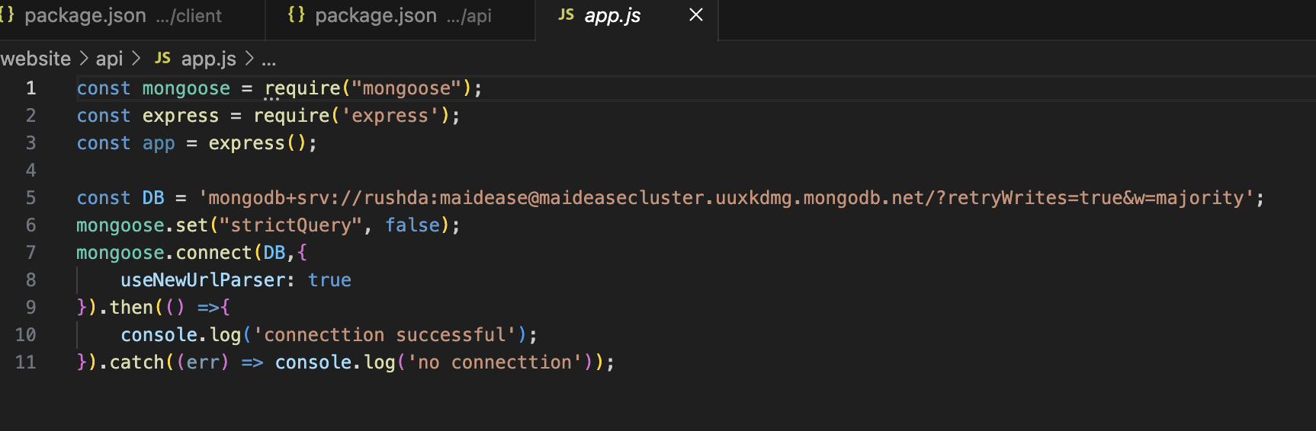
Database connection

Slide 14
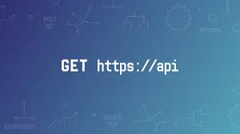
API Calls
Register, Login, GetProfile, Edit, Delete

Slide 15
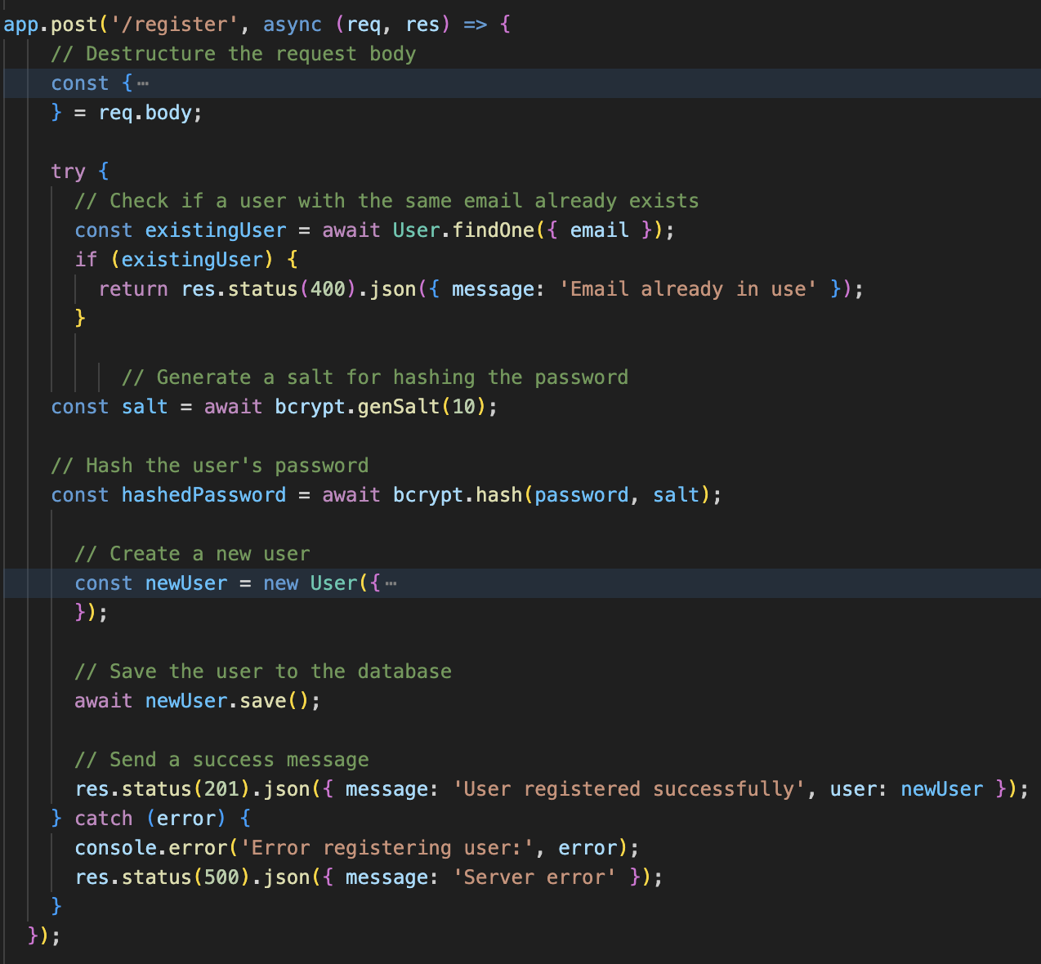

Register

Slide 16
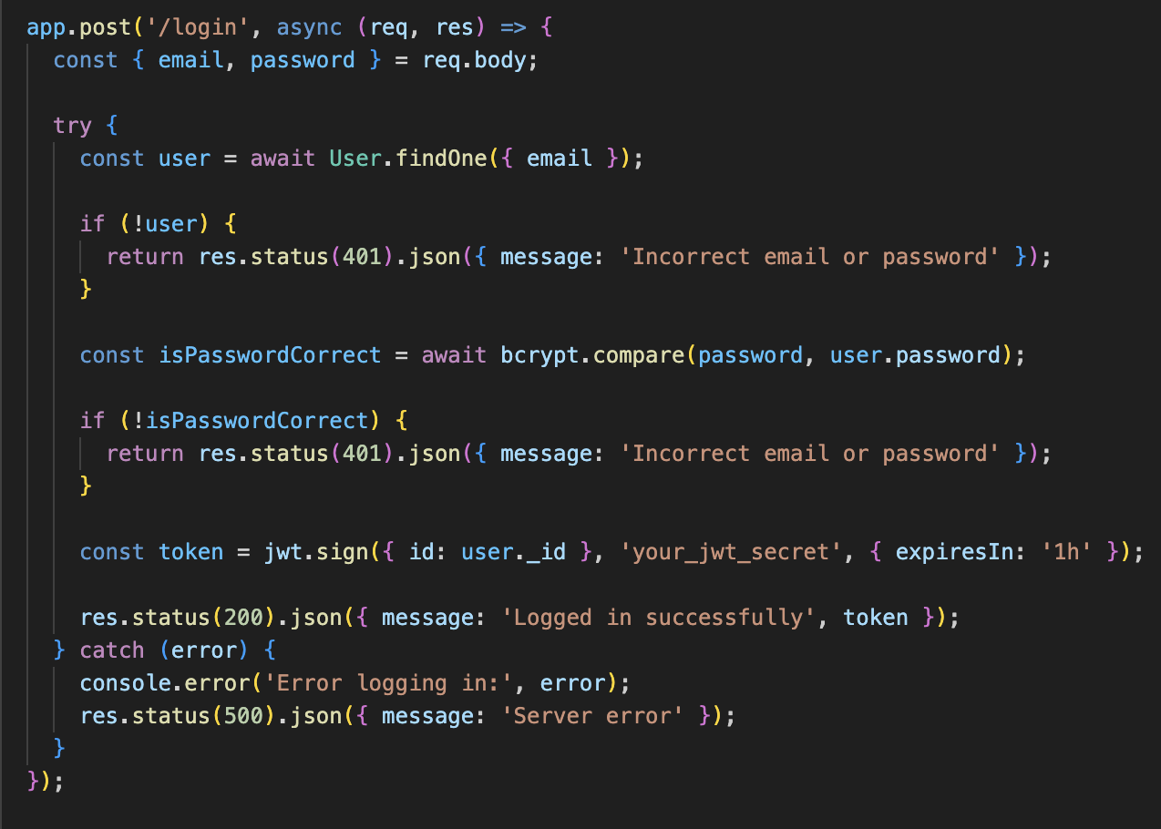

Login

Slide 17
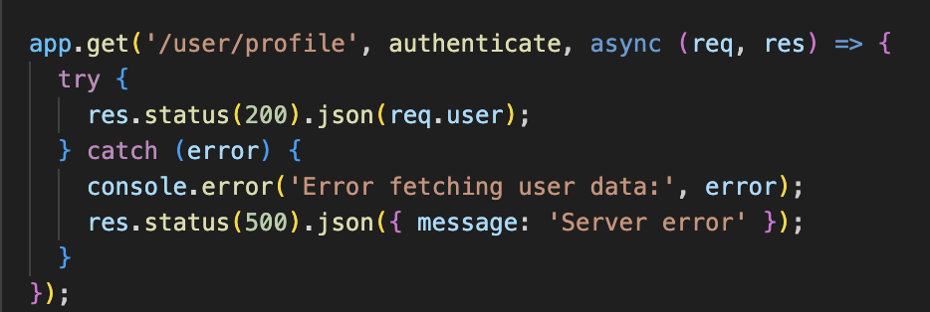
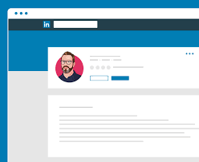
GetProfile (/user/profile)

Slide 18
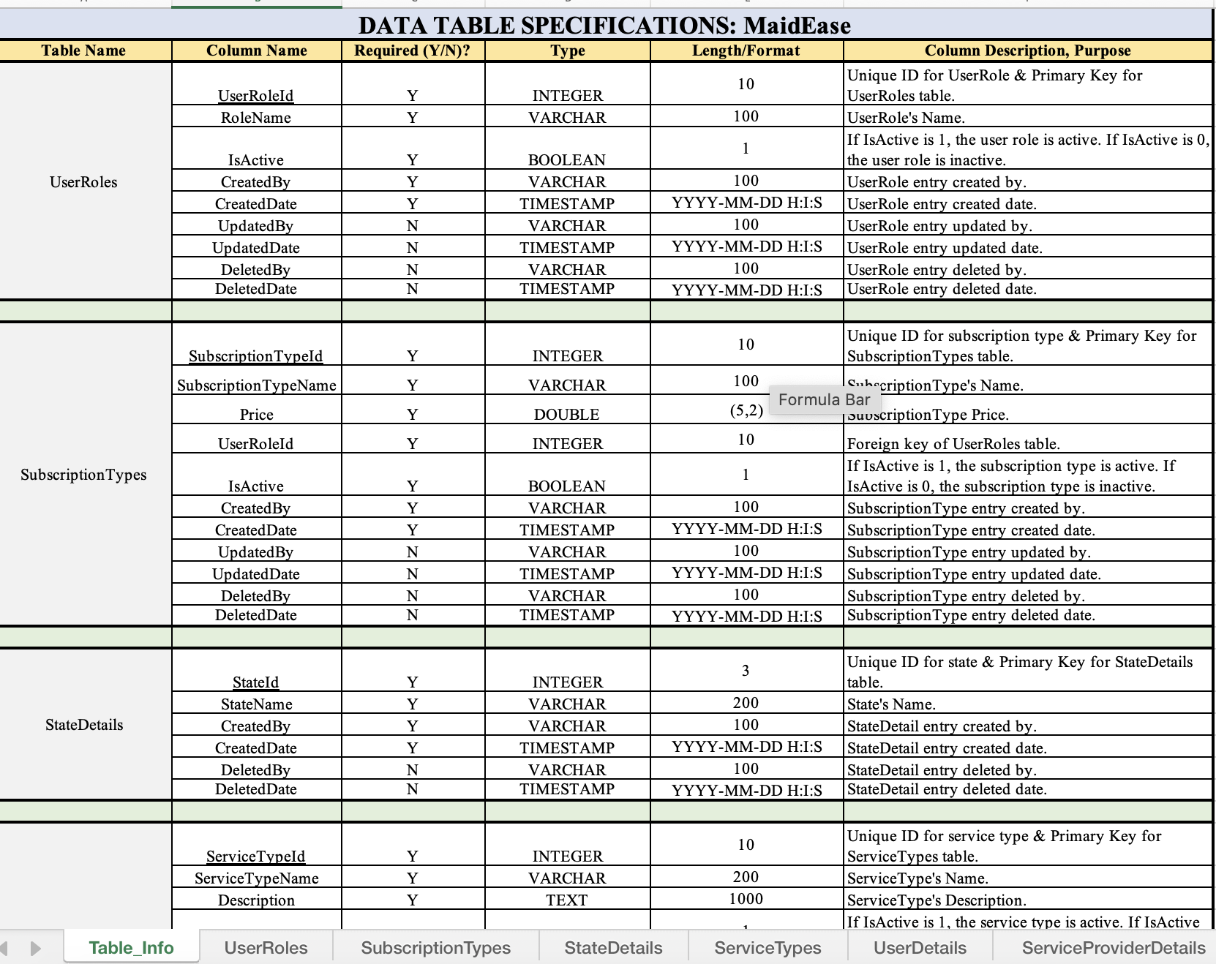
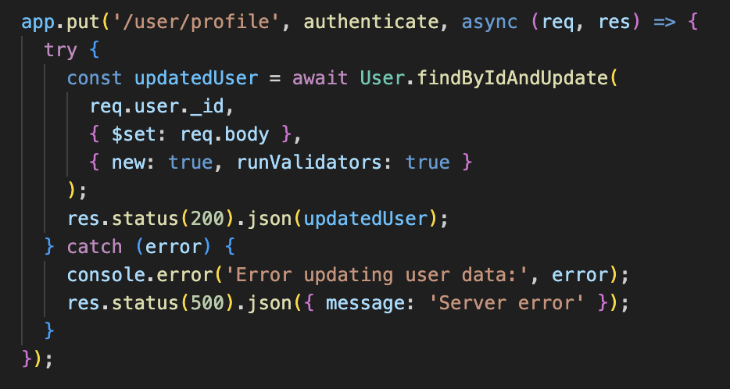

Table Specification
Edit

Slide 19
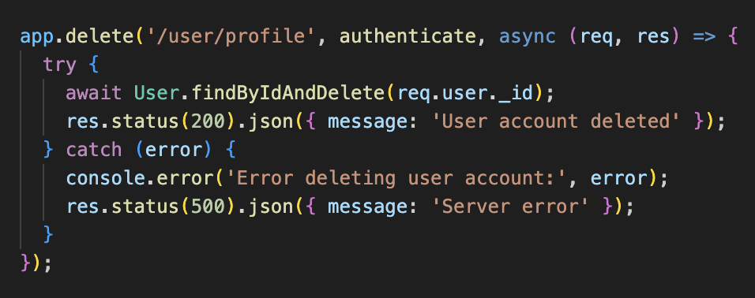

Delete

Slide 20


UI/ UX (Homepage, Login, Register, Profile, Edit, Delete)

Slide 21
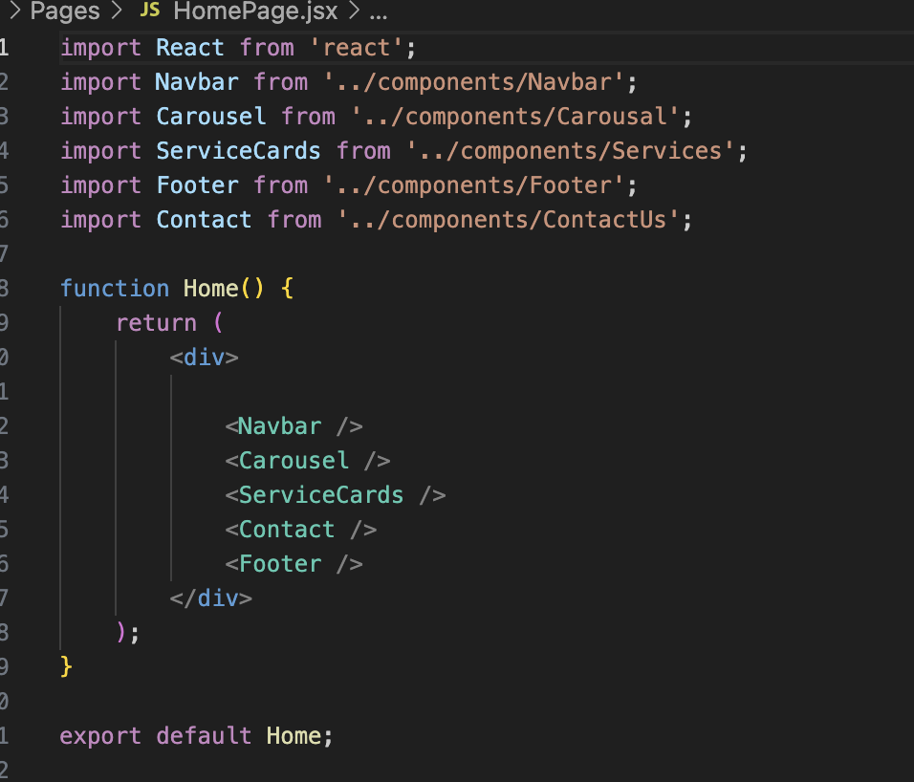
Homepage

Slide 22
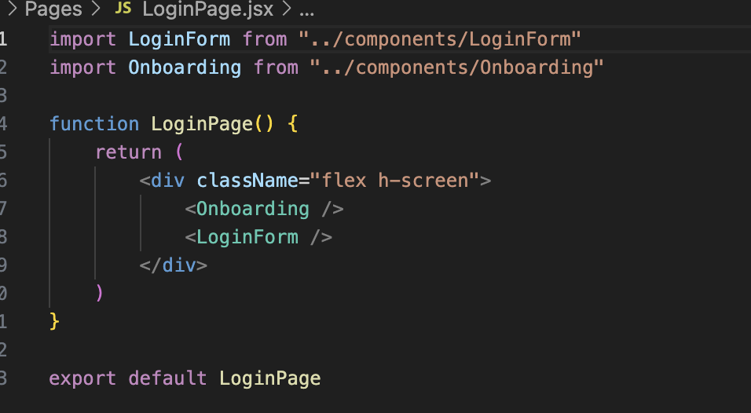
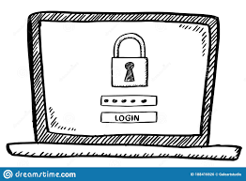
Login

Slide 23
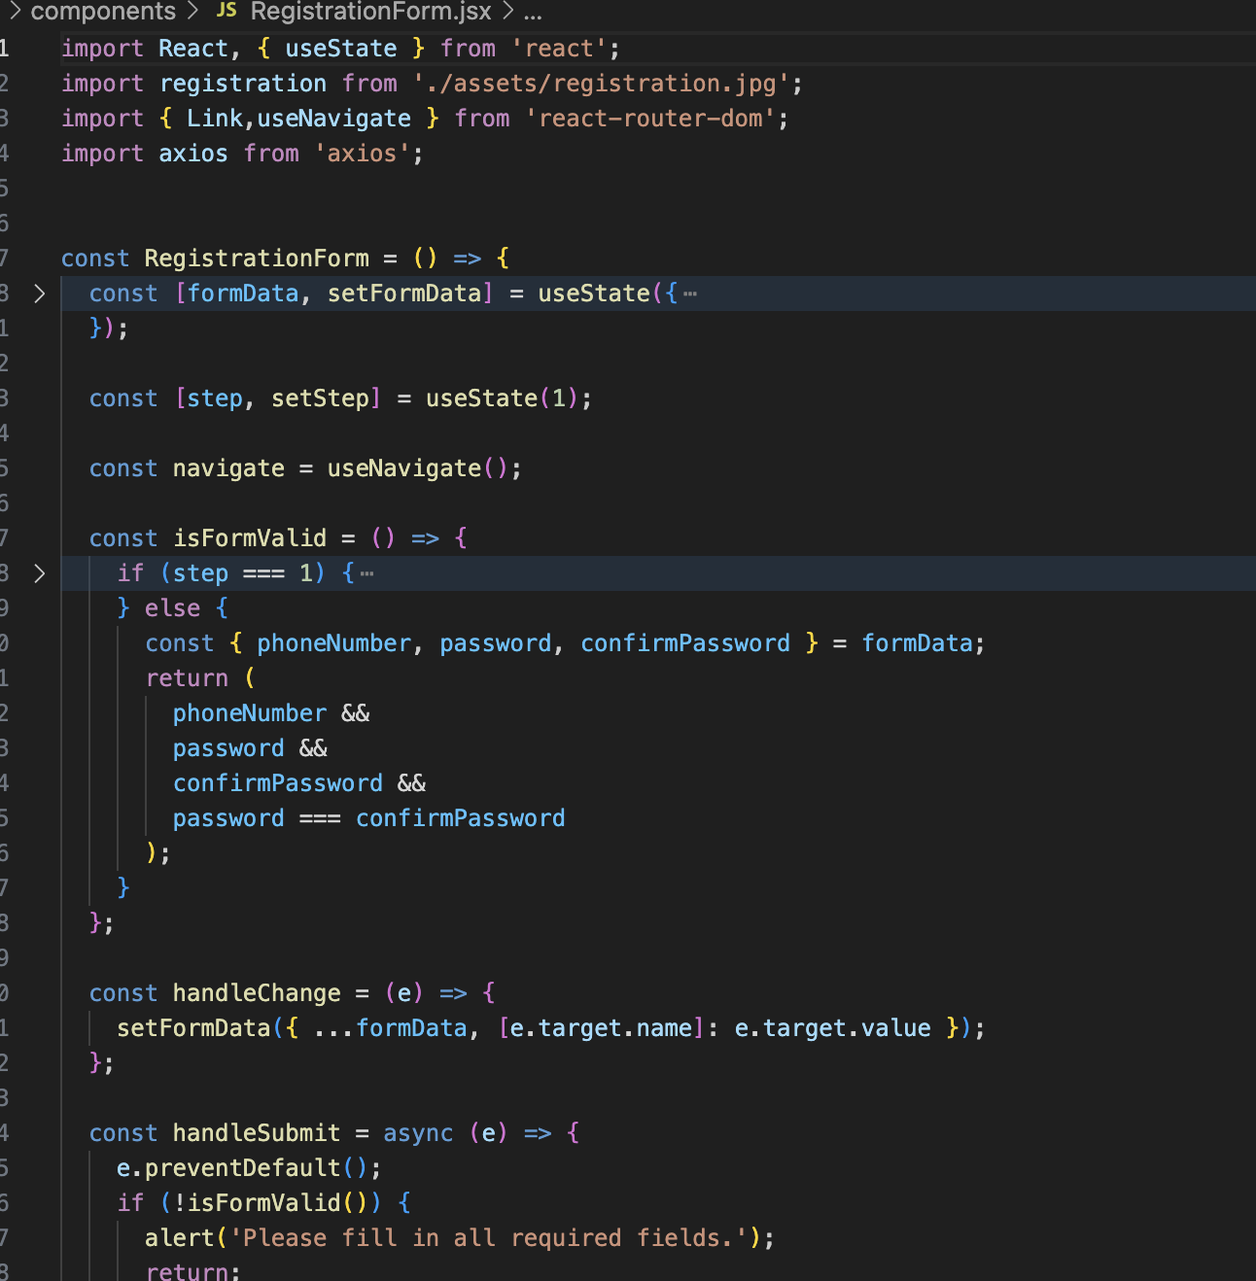

Register

Slide 24
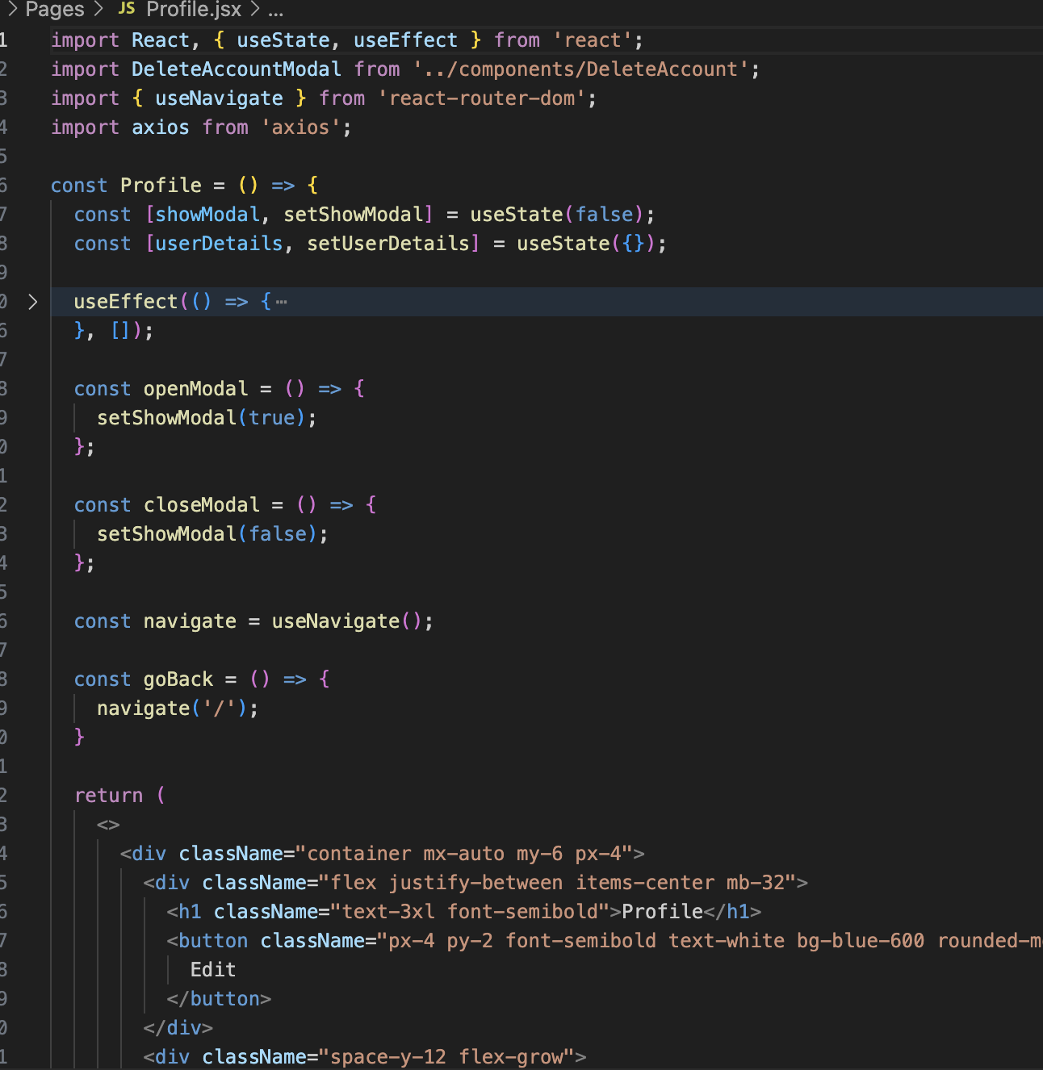

Profile

Slide 25
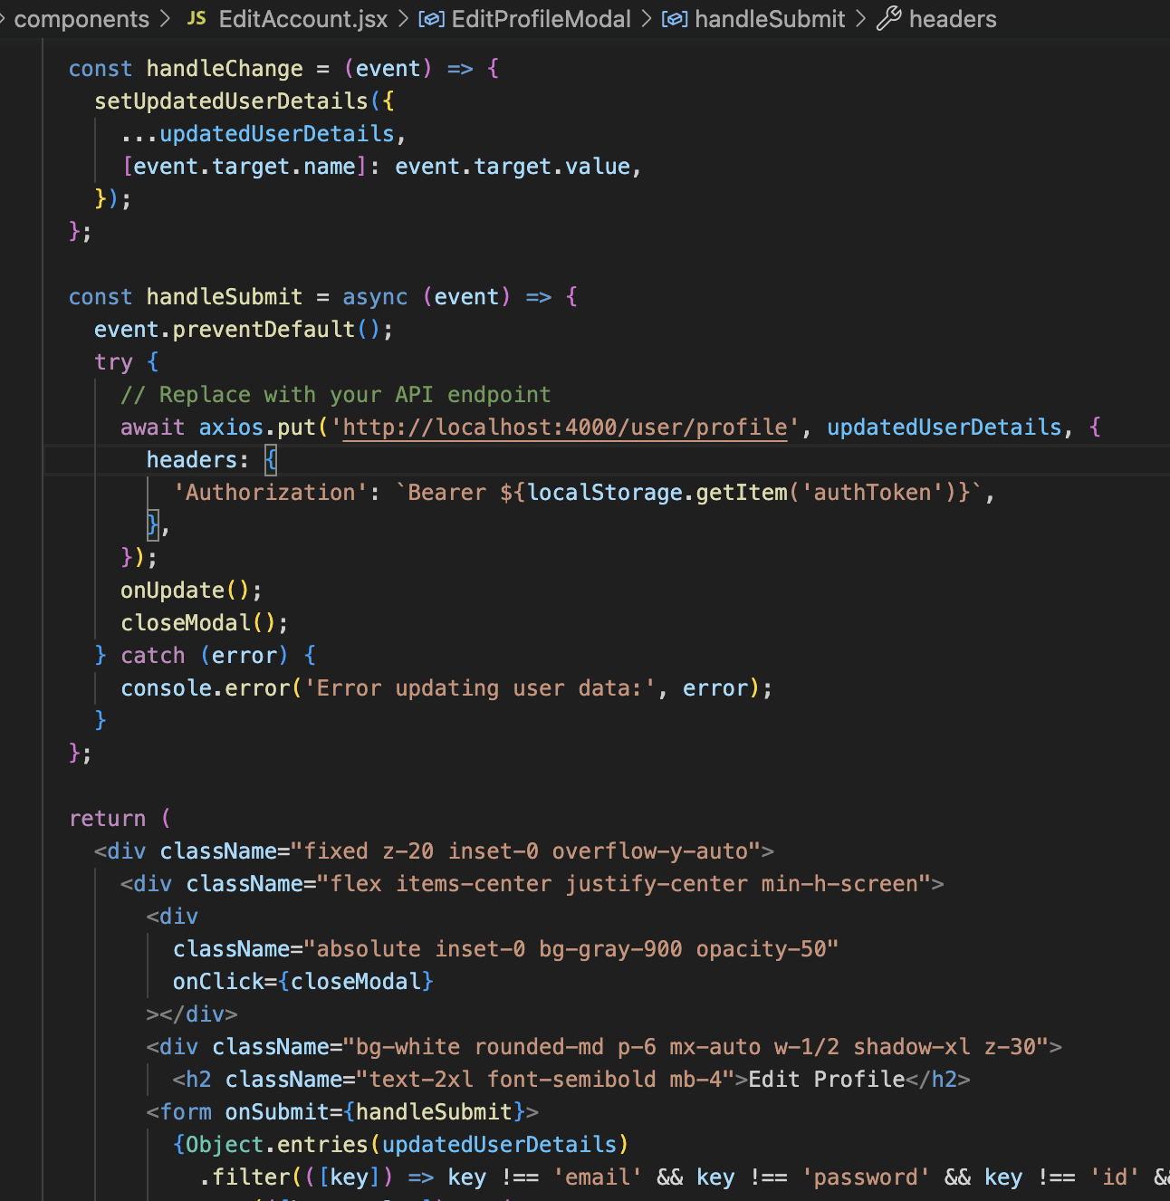

Edit

Slide 26
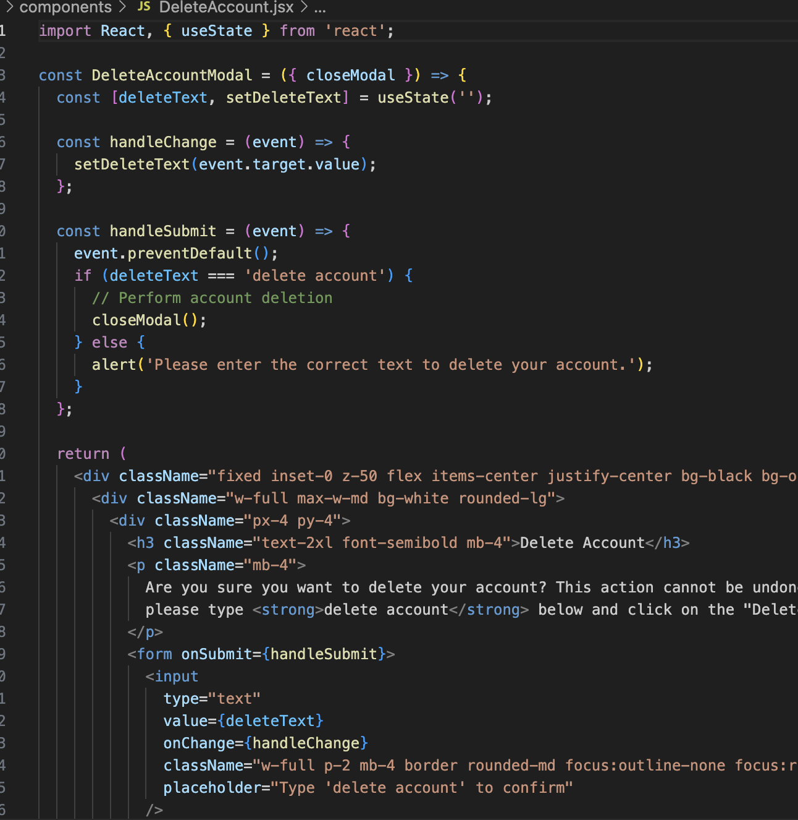

Delete

Slide 27
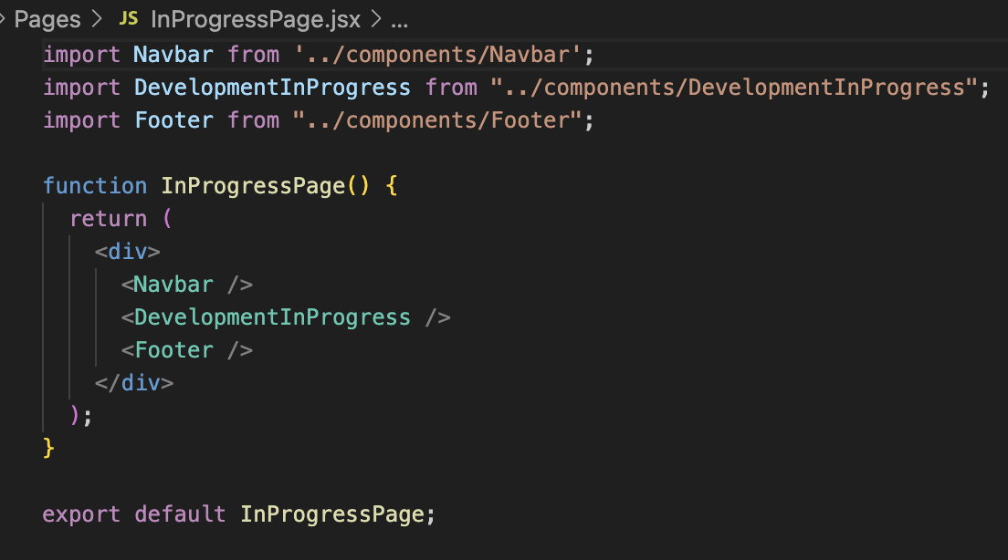
Development in Progress

